Slide 1
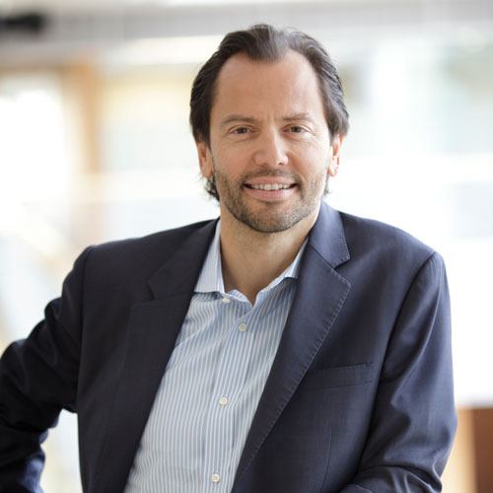
In Search of New Foundations Luigi Zingales
Modified and Presented by Carter Zagorski
Spring 2023

Slide 2
Key Arguments and Contributions
Corporate finance is deeply rooted in an underpinning theory of the firm.
Existing theories of the firm have fallen short of explaining changes in the nature of the firm.
Establishes the need for a new theory of the firm and outlines its characteristics.

Slide 3
Five Sections of this Article
I: Analyzes corporate finance (CF) and its name.
II: Details research-related consequences of CF including problem areas that have been ignored.
III: Discusses CF’s roots in the underpinning theory of the firm and the resulting implications.
IV: Posits that helpful existing theories are increasingly ineffective with emerging types of firms.
V: Outlines characteristics that a new theory should satisfy and suggests impacts on CF views.

Slide 4
Section I: What is Corporate Finance?
Corporate Finance (CF): Study of how firms are financed or the business of financing business.
Distinct from real estate finance, personal/consumer finance, etc.
Three main areas of CF:
Capital Structure: Distortions associated with different ways of financing
Corporate Governance: Optimal governance structure for the firm
Valuation: Valuation of the firm
Notes:
Formal - Practice of actively raising capital from a large public of investors for the purpose of undertaking new private ventures.

Slide 5
Sections I and II: Not Just Semantics – Origins of Corporate Finance
Concerns the financing of enterprises: unique combinations of physical and human capital.
For historical reasons, the idea of enterprise that became ingrained in corporate finance coincided with the legal notion of corporation.
Disproportionate focus on large firms:
Disproportionate amount of research dedicated to large publicly traded companies is simply an effect of data availability.
The access to datasets, such as COMPUSTAT, facilitated this type of research, whereas the difficulty in obtaining information about privately held companies prevented the other type.

Slide 6
Section III: The Theory-of-the-firm Foundations of CF
Why do we need this link? Many unanswered questions:
Capital Structure perspective:
Why is value lost in liquidating a firm? Why is a firm worth more than the sum of all its components?
Governance perspective:
Why do we need any form of authority? Isn’t the market responsible for allocating all resources efficiently without the intervention of any authority?

Slide 7
Section III: The Theory-of-the-firm Foundations of CF
Valuation perspective:
Value created by a firm = Discounted sum of payoffs generated by the firm – Opportunity cost of inputs used
This economic understanding of a firm’s valuation leaves gaps in our understanding of the true value of the firm.
E.g., unionized workers tend to be paid above their opportunity cost. Total value of the firm, thus, should include the rent appropriated by unions.

Slide 8
Section III: The Theory-of-the-firm Foundations of CF
Existing Theories of the Firm… And their Incompleteness
Firm as a Nexus of Explicit and Implicit Contracts
Firm as a Collection of Growth Options
Firm as a Collection of Assets

Slide 9
The Firm as a Nexus of Explicit and Implicit Contracts
May seem like a minor variation of only explicit contracts (Alchian & Demestz, 1972; Jensen & Meckling, 1976); prevailing view of the firm in corporate finance, but it changes conceptual framework dramatically.
A firm ≠ sum of components readily available on the market but is a unique combination which can be worth more or less than the sum of its parts.
Difference is the net of value of organizational assets and liabilities: “Organizational Capital.”
E.g., Suppliers and customers have implicit contracts with the firm.

Slide 10
The Firm as a Collection of Growth Options
Myers (1977) defines the firm as a collection of assets in place and growth opportunities.
Two shortcomings (thus incomplete):
Does not provide explanations of what the “glue” is that keeps the growth opportunities attached to the assets in place.
How the inner workings of this entity differ from the workings of the marketplace.

Slide 11
Firm as a Collection of Assets
Shortcoming: Why do firms spend billions to merge?
If the firm is simply a collection of contracts, the results achieved through a merger could be more simply obtained by writing a contract between two separate firms.

Slide 12
Section IV: The Nature of the Firm Has Changed
A typical firm is no longer a Chandlerian firm - i.e., asset intensive and highly vertically integrated (Richard Whittington warns against this though!).
Traditional firm had a high degree of control over its employees. Now, employees are not merely automata in charge of operating valuable assets but valuable assets themselves, operating with commodity-like physical assets.
Owing to size and asset intensity, traditional firms had dispersed investors.

Slide 13
The New Firm
Three major changes in the balance of power within firms:
Physical assets have become less unique ⬄ Improvements in capital markets have made it easier to finance expensive assets.
Increased global competition has increased demand for process innovation, which can only be generated by talented employees ⬄ Importance of HC.
Firms have lost their grip on HC due to increased employees’ outside options.

Slide 14
Features of the “old” and “new” firm
The “Old” Firm
The “New” Firm
Vertically integrated
Asset-intensive
High degree of control over employees/High power of management
Owned by disperse investors
Non-vertically integrated
Human capital-intensive
High-competition environment
Limited exercise of authority by management

Slide 15
Section V: A New Agenda
Questions must be addressed by the new theory of the firm:
The defining characteristic of a firm is that it substitutes authority for the price mechanism in determining how decisions are made (Coase (1937). Theory of the firm should address how an organization succeeds in acquiring power that differs from “ordinary market contracting between any two people” – especially in the absence of physical asset-intensive firms
How is power maintained and how is it lost?
How does authority-based system operate differently from ordinary market contracting?
Understanding the internal workings of firms
How the surplus generated by the firm is allocated among its members

Slide 16
Part B: An Attempt
Q1 “How a third party can have control over human capital..”?
“By controlling a critical resource an entrepreneur can influence the accumulation of specific investments so as to build complementarities between the person the entrepreneur seeks to have power over and her critical resource. Once the complementarity exists, the specialized person may obey orders from the entrepreneur for fear that disobedience would jeopardize the joint value they can create together.”
Q2 - How is power maintained and how is it lost?
“Power is maintained and increased by having more and more people specializing; thus, at some point the critical resource becomes the web of specific investment itself”

Slide 17
Open Ends (non-exhaustive list)
There is a pressing need to understand what factors determine the ability of firms to capture new growth opportunities. The theory focuses on the degree of complementarity. But how can we measure it? And what is the predictive power of such an idea? An answer to these questions will be crucial to deriving the value of the entire enterprise.
We need to know how the surplus generated by a firm is allocated among its members.

Slide 18
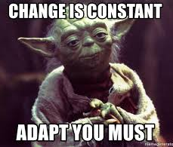
Conclusion
Financing and governance choices change the boundaries of human capital-intensive firms (no longer primarily asset-intensive firms). A new theory of the firm changes how CF is viewed theoretically and empirically.

Slide 19
Discussion Questions
Traditional firms’ valuation would be able to capture the value of assets (mostly physical). What are some measures for measuring human capital – their talent and other qualitative aspects? Similarly, access to data resources (e.g., Facebook, Google)?
How does a merging of two stakeholders, say, suppliers and customers, as in the case of platforms such as Facebook, Tinder, etc. change the balance of attention/power/claimant rights?
Relatedly, should users of these data-collection applications receive more property rights (pie-share)?

